Slide 1

Phases of Compilation
- Deepali M. Raikar

Slide 2
Phases of Compiler
The structure of compiler consists of two parts:
Analysis part
Synthesis part

Slide 3

Analysis part
• Analysis part breaks the source program into constituent pieces and imposes a grammatical structure on them which further uses this structure to create an intermediate representation of the source program.
• It is also termed as front end of compiler.
• Information about the source program is collected and stored in a data structure called symbol table.

Slide 4

Synthesis part
• Synthesis part takes the intermediate representation as input and transforms it to the target program.
• It is also termed as back end of compiler.

Slide 5
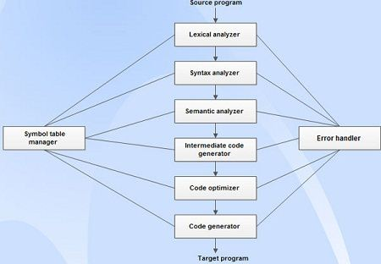
The phases of a compiler :
1. Lexical analysis
2. Syntax analysis
3. Semantic analysis
4. Intermediate code generation
5. Code optimization
6. Code generation
7.Symbol table management.
8.Error handling

Slide 6
Lexical Analysis
• Lexical analysis is the first phase of compiler which is also termed as scanning.
• Source program is scanned to read the stream of characters and those characters are grouped to form a sequence called lexemes which produces token as output.
Token: Token is a sequence of characters that represent lexical unit, which matches with the pattern, such as keywords, operators, identifiers etc.
Lexeme: Lexeme is instance of a token i.e., group of characters forming a token. ,
Pattern: Pattern describes the rule that the lexemes of a token takes. It is the structure that must be matched by strings.
• Once a token is generated the corresponding entry is made in the symbol table.

Slide 7
Input: stream of characters
Output: Token
Token Template: <token-name, attribute-value>
(eg.) c=a+b*5;

Slide 8
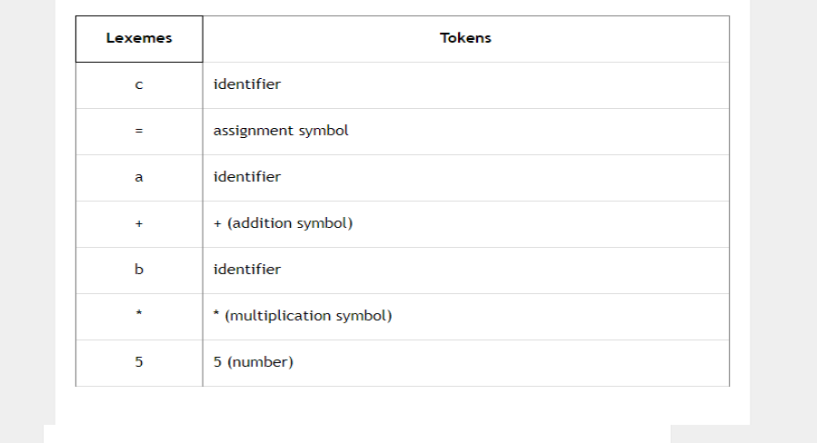
Lexemes and tokens
Hence, <id, 1><=>< id, 2>< +><id, 3 >< * >< 5>

Slide 9
Syntax Analysis
Syntax analysis is the second phase of compiler which is also called as parsing.
• Parser converts the tokens produced by lexical analyzer into a tree like representation called parse tree.
• A parse tree describes the syntactic structure of the input.
Syntax tree is a compressed representation of the parse tree in which the operators appear as interior nodes and the operands of the operator are the children of the node for that operator.

Slide 10
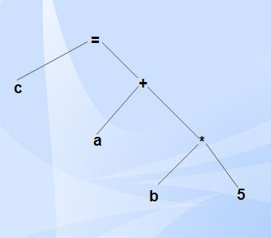
Input: Tokens
Output: Syntax tree

Slide 11
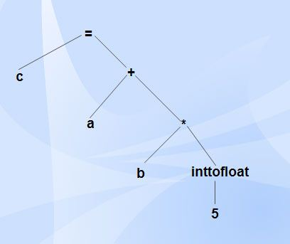
Semantic Analysis
• Semantic analysis is the third phase of compiler.
• It checks for the semantic consistency.
• Type information is gathered and stored in symbol table or in syntax tree.
• Performs type checking.

Slide 12
Intermediate Code Generation
• Intermediate code generation produces intermediate representations for the source program which are of the following forms:
o Postfix notation
o Three address code
o Syntax tree
Most commonly used form is the three address code.
t₁ = inttofloat (5)
t₂ = id₃* tl
t₃ = id₂ + t₂
id₁ = t₃

Slide 13
Properties of intermediate code
• It should be easy to produce.
• It should be easy to translate into target program.

Slide 14
Code Optimization
• Code optimization phase gets the intermediate code as input and produces optimized intermediate code as output.
• It results in faster running machine code.
• It can be done by reducing the number of lines of code for a program.
• This phase reduces the redundant code and attempts to improve the intermediate code so that faster-running machine code will result.
• During the code optimization, the result of the program is not affected.

Slide 15
• To improve the code generation, the optimization involves
Deduction and removal of dead code (unreachable code).
Calculation of constants in expressions and terms.
Collapsing of repeated expression into temporary string.
Loop unrolling.
Moving code outside the loop.
Removal of unwanted temporary variables.
t₁ = id₃* 5.0
id₁ = id₂ + t₁

Slide 16
Code Generation
• Code generation is the final phase of a compiler.
• It gets input from code optimization phase and produces the target code or object code as result.
• Intermediate instructions are translated into a sequence of machine instructions that perform the same task.
• The code generation involves
o Allocation of register and memory.
o Generation of correct references.
o Generation of correct data types.
o Generation of missing code.
LDF R₂, id₃
MULF R₂, # 5.0
LDF R₁, id₂
ADDF R₁, R₂
STF id₁, R₁

Slide 17
Symbol Table Management
• Symbol table is used to store all the information about identifiers used in the program.
• It is a data structure containing a record for each identifier, with fields for the attributes of the identifier.
• It allows finding the record for each identifier quickly and to store or retrieve data from that record.
• Whenever an identifier is detected in any of the phases, it is stored in the symbol table.

Slide 18
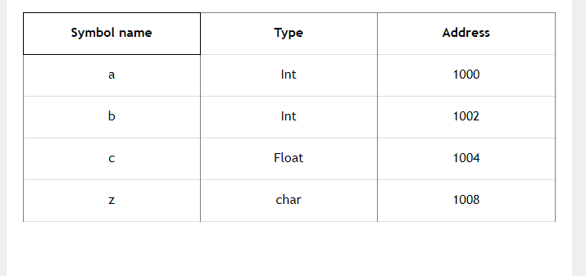
Example
int a, b; float c; char z;

Slide 19
Error Handling
• Each phase can encounter errors. After detecting an error, a phase must handle the error so that compilation can proceed.
• In lexical analysis, errors occur in separation of tokens.
• In syntax analysis, errors occur during construction of syntax tree.
• In semantic analysis, errors may occur at the following cases:
(i) When the compiler detects constructs that have right syntactic structure but no meaning
(ii) During type conversion.
• In code optimization, errors occur when the result is affected by the optimization. In code generation, it shows error when code is missing etc.

Slide 20
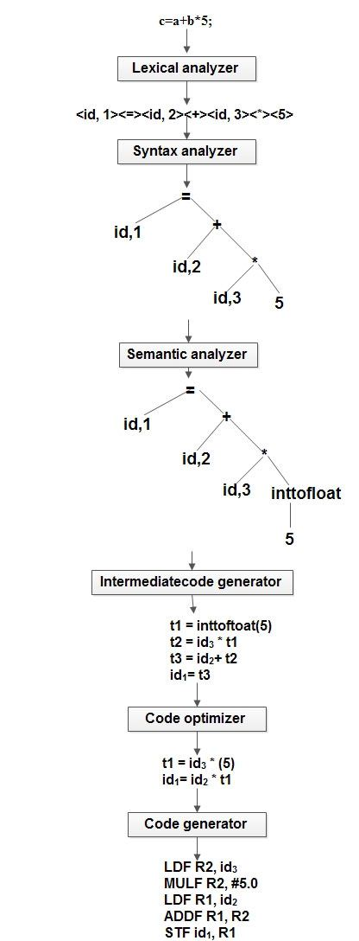

Slide 21
References
Ecomputernotes.com
Compiler design – Aho, Ulman
Compiler Design – Dr. R. Venkatesh
www.geeksforgeeks.org

Slide 22
THANK YOU

